Slide 1



More From Music
music through a cochlear implant
Dr Rachel van Besouw
Hearing & Balance Centre, ISVR
Notes:
Introduction

Slide 2
What will I learn in the next 25 minutes?
What a cochlear implant (CI) is and who can have one
What a CI sound processor does
How CI hearing compares to normal hearing
Why music is particularly challenging for CI users
How to get More From Music…
Notes:
Over the next 25 minutes or so, I hope to describe to you:
What a cochlear implant is and who can have one
What a cochlear implant sound processor does
How hearing with a cochlear implant compares to normal hearing
Why music is particularly challenging for cochlear implant users and
How to get More From Music with an implant…

Slide 3
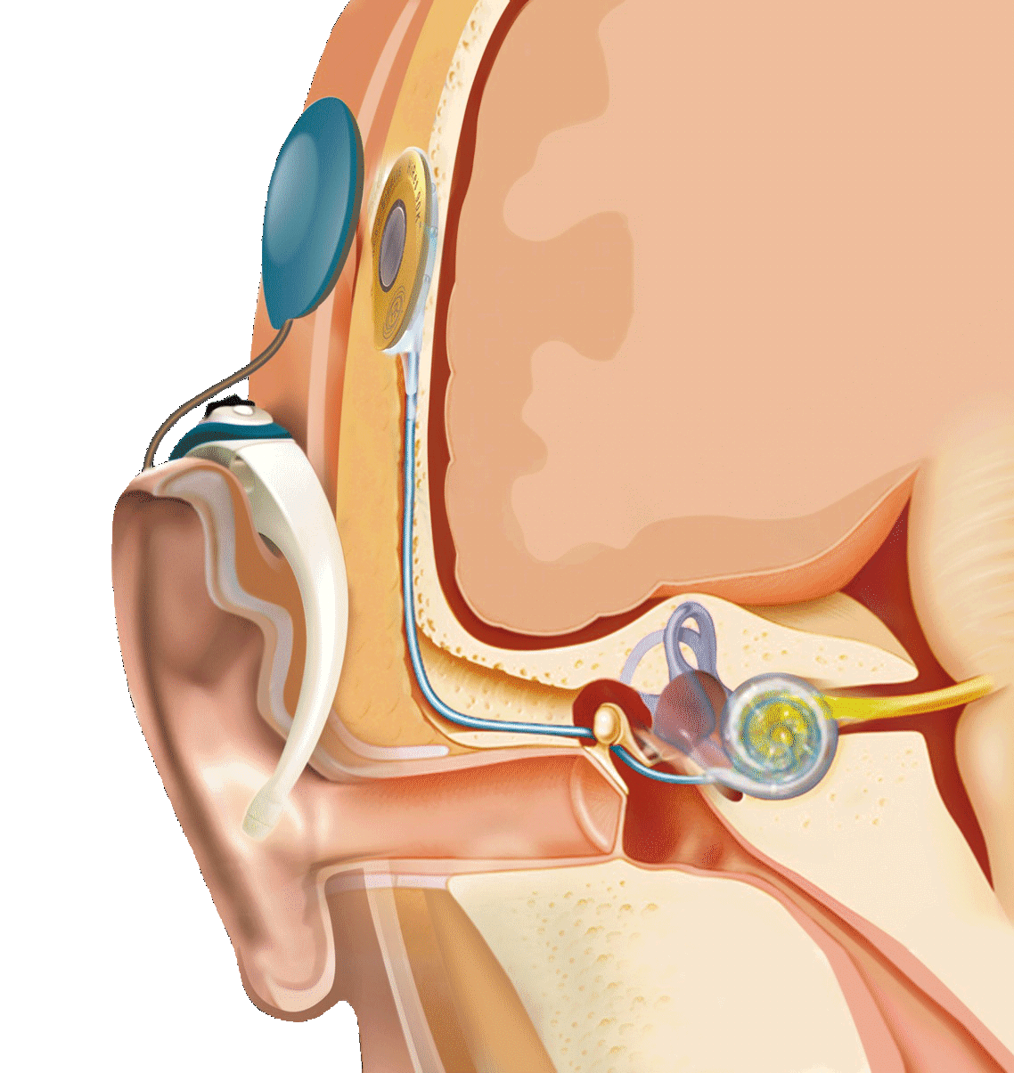
What is a CI?
A CI is a surgically implanted device that electrically stimulates the auditory nerve fibres in the inner ear
Image courtesy of AB
Notes:
What is a cochlear implant or ‘CI’?
A cochlear implant is a surgically implanted device that electrically stimulates the auditory nerve fibres in the inner ear. Before I go any further, lets remind ourselves about how the ear normally functions.

Slide 4
What is a CI?
Ossicles
(hammer, anvil & stirrup)
Cochlea
Pinna
Ear canal
Ear drum
Auditory nerve
Image courtesy of AB
Notes:
The outer part of the ear is called the pinna. The various dips and ridges of the pinna provide us with important localisation cues so that we can work out where a sound is coming from. Sound waves travel down the ear canal and cause the ear drum to vibrate. Behind the ear drum are the three smallest bones in the human body; the hammer, the anvil and the stirrup, which also vibrate. The stirrup pushes against a window to the cochlea, which has three fluid-filled chambers separated by membranes. The vibrations of the stirrup ultimately cause the membranes in the cochlea to vibrate. On one of these membranes lies thousands of hair cells, with even smaller fronds on top that move in response to the motion of the membranes, and these trigger action potentials in the auditory nerve fibres, which send sound information on to the brain…

Slide 5
What is a CI?
Receiver coil & stimulator
Transmitter coil
Sound processor
Electrode array
Microphone(s)
Image courtesy of AB
Notes:
A cochlear implant has an external part that is worn behind the ear and looks a bit like a hearing aid, but unlike a hearing aid, it has a transmitter coil to communicate with the internal, implanted device.
The external part consists of: a microphone or two that captures sound and turns it into an electrical signal; the sound processor, which is typically worn behind the ear; and a transmitter coil that transmits sound information using radio frequency to an implanted receiver coil. The receiver then stimulates an electrode array which is inserted into the cochlea. The electrodes stimulate the auditory nerve fibres directly using pulses of electrical current, so the ear canal, ear drum and the hammer, anvil and stirrup are all bypassed.
Cochlear implants typically have between 12 and 22 electrodes that are inserted into the cochlea.

Slide 6
Who is it for?
People with severe-to-profound hearing loss in both ears
Due to abnormalities in the cochlea
Cochlea
Image courtesy of AB
Notes:
Cochlear implants are used for people with severe or profound hearing loss in both ears, who receive little benefit from hearing aids… and where the type of hearing loss is due to abnormalities in the cochlea.

Slide 7
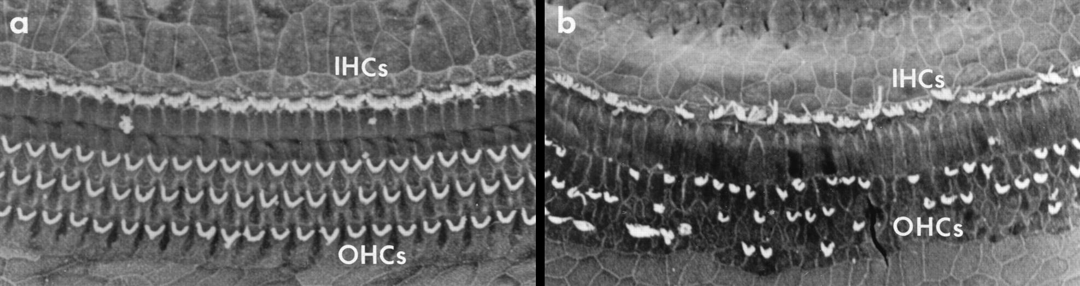
What causes this type of hearing loss?
Aging
Noise
Certain medicines
Viral and bacterial infection
(rubella, measles, meningitis)
Ménière’s disease
Genetic origin
Premature birth
Head injury
Abnormal cochleae
Micrographs: Keithley, E.M. in: Ryan, A.F. PNAS 2000;97:6939-6940
Notes:
There are many causes of cochlear hearing loss – on this slide is a list of common causes.
Here, on the left, we have an image of the hair cells in the healthy cochlea and you can see that on the top of each hair cell are tiny fronds shown here in white. On the right we have a damaged cochlea. In the damaged cochlea many of the cells have died away and so there is no way for sound vibration information to be converted into auditory nerve action potentials. This is the classic problem that a cochlear implant addresses.
It is worth mentioning here that in the healthy ear there are about 16,000 hair cells in total and that these are connected to about 30,000 auditory nerve fibres. Cochlear implants only have been 12 and 22 electrodes doing this job.

Slide 8
What will I learn in the next 25 minutes?
What a cochlear implant (CI) is and who can have one
What a CI sound processor does
How CI hearing compares to normal hearing
Why music is particularly challenging for CI users
How to get More From Music…
Notes:
So what does a cochlear implant sound processor actually do?

Slide 9
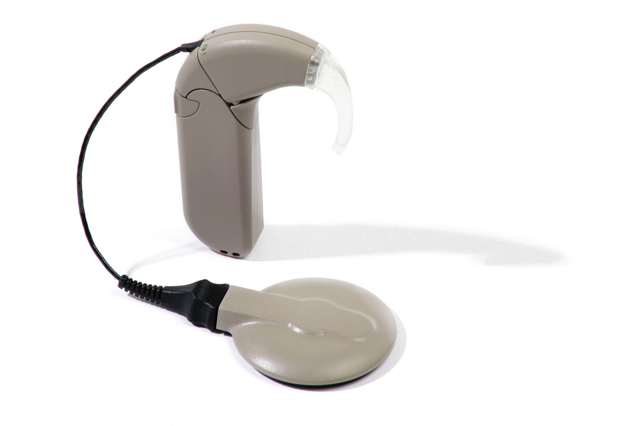
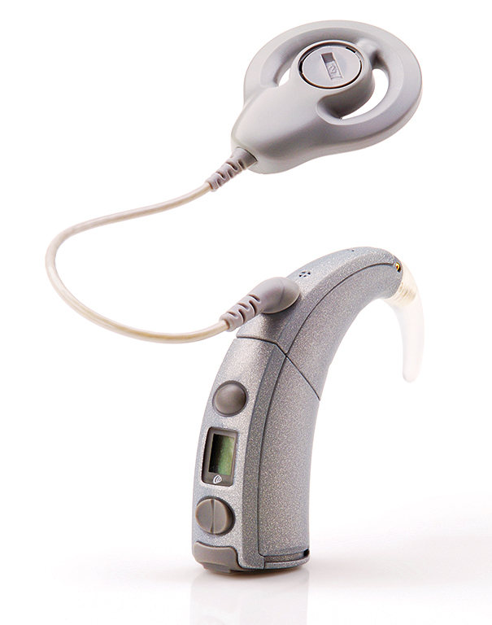
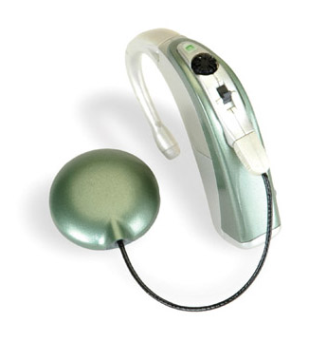
What does a CI sound processor do?
microphone(s)
transmitter coil
sound processor
Notes:
Here are sound processors from Cochlear, Med-El and Advanced Bionics. All these devices have the same basic components. They all have a microphone or two, the processor that does all the hard work, and a transmitter coil to transmit information to the implant, which stimulates the electrodes.

Slide 10
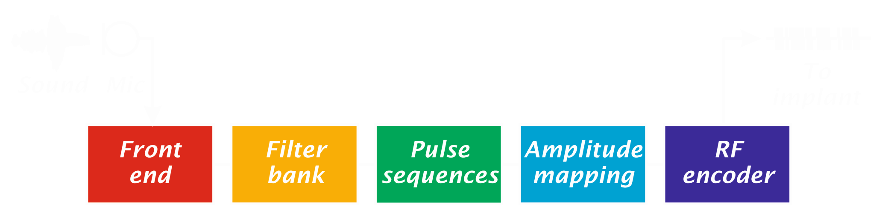
Sound processing stages
Pre-emphasis (boosts frequencies important for speech)
Automatic gain control (compresses the loudness range)
Speech enhancement (reduces unwanted background noise)
Notes:
First, sound is captured by the microphone and turned into an electrical signal. It is then fed to this ‘front end’ block. In this block certain pitches or ‘frequencies’ are boosted which are important for speech. Quiet sounds are also boosted and loud sounds are reduced in amplitude, so that the overall range of loudness is compressed. This has to be done as the range of loudness (as known as the ‘dynamic range’) that can be conveyed by the electrodes is rather small. Speech enhancement may also be used to reduce background noise.

Slide 11
Sound processing stages
Splits the sound signal into frequency bands (the number of bands depends on the number of available electrodes)
Notes:
The sound signal is then fed into a bank of filters or ‘filter bank’. This splits up the signal into a number of bands. If you have 22 active electrodes, this block splits the signal up into 22 bands. If you have 16 electrodes, this block splits the signal up into 16 bands. This is so we can send frequency or ‘pitch’ information to the appropriate region in the cochlea.

Slide 12
Sound processing stages
Generates the pulse sequences for each electrode
Notes:
The ‘pulse sequence’ block turns the signal in each of the frequency bands into a series of electrical pulses.

Slide 13
Sound processing stages
Sets the amplitude range for each electrode
(ensures that the amplitudes of the pulses are above threshold, but below the most comfortable loudness level)
Notes:
The amplitude mapping block is used to set the maximum and minimum level of the pulses so that the quietest sounds that you want to hear can be heard and so the loudest sounds that you hear are not uncomfortable. This is done by clinicians in ‘mapping’ or ‘tuning’ sessions.

Slide 14
Sound processing stages
Turns the data into a radio frequency (RF) signal for transmission to the implant
Notes:
Finally, the radio frequency encoder block turns the channels of pulses into a radio frequency signal, so that it can be transmitted to the implant.
All this happens in the sound processor and the processing has important implications for music (particularly the filterbank block, which is limited by the number of electrodes).

Slide 15
What will I learn in the next 25 minutes?
What a cochlear implant (CI) is and who can have one
What a CI sound processor does
How CI hearing compares to normal hearing
Why music is particularly challenging for CI users
How to get More From Music…
Notes:
How does cochlear implant hearing compare to normal hearing?

Slide 16

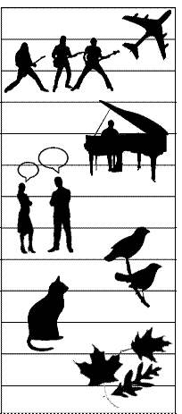
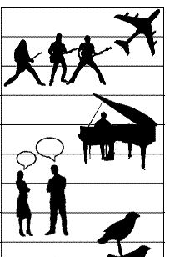








How does a CI compare to normal hearing?
Loudness & Dynamic Range
decibels
120
110
100
90
80
70
60
50
40
30
20
10
0
-10
loud
soft
Notes:
Hearing with a cochlear implant differs to normal hearing in a number of ways, not least because it involves stimulating the auditory nerve fibres artificially, with pulses of electrical current from a very small number of electrodes.
Lets consider the dynamic range of the normal hearing system to start with. From the quietest sound that we are able to perceive to the loudest sound that causes pain, we typically have a dynamic range of about 120 decibels. The sound of falling leaves are somewhere between 0 and 10 decibels, a purring cat is about 20 dB, bird song is a bit louder… conversational speech is around 50-60 dB, piano practise can be between 70-90 dB, rock concerts can easily exceed 100 dB and a plane taking off can be uncomfortably loud depending on how close you are.
The sensitivity of a cochlear implant varies depending on manufacturer and setting, but in general, there is a threshold below which the implant will not convey any information. For example, falling or rustling leaves, a cat purring and distant bird song might not be picked up by the implant.

Slide 17
How does a CI compare to normal hearing?
Loudness & Dynamic Range
decibels
120
110
100
90
80
70
60
50
40
30
20
10
0
-10
loud
~20 dB range
soft
Notes:
In addition, the range of loudness that can be conveyed using different sized electrical pulses is very small. Therefore soft sounds are made louder and loud sounds are made softer, squishing or compressing the range down to about 20 dB.

Slide 18

How does a CI compare to normal hearing?
Pitch
Notes:
Now lets consider what happens to pitch perception with a cochlear implant.
The cochlea is a frequency analyser; it splits sounds up into different frequencies or ‘pitches’. The outer-most spiral of the cochlea is responsive to high frequencies and the inner-most spiral or ‘apex’ of the cochlea is responsive to low frequencies.

Slide 19
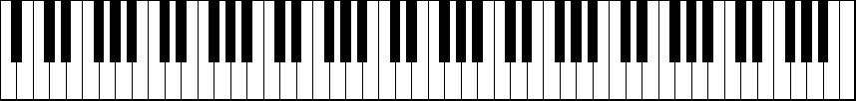

How does a CI compare to normal hearing?
Pitch
low pitch info
CI input
high pitch info
low pitch region in cochlea
CI output
high pitch region in cochlea
Notes:
If we unroll the cochlea, as I have shown here, we have a cochlea that goes from low frequencies gradually to high frequencies as we move from left to right, much like a piano.
A cochlear implant is inserted into the outer-most spiral. How deep it goes into the cochlea depends on factors such as the type of implant and the condition of the cochlea.
The speech processor maps frequencies that are important, particularly for speech, to each electrode – as I have illustrated with the piano keyboard above. Notice that many of the notes on the keyboard are not mapped to electrodes at all. Most implants do not convey frequencies below about 100 or 200 Hz, as these are not deemed essential for speech and because there are only a limited number of electrodes available (here I have shown 16 electrodes).
However, the frequency region that an electrode stimulates in the cochlea does not necessarily match the frequency content that it receives from the speech processor. On this keyboard I have indicated where ‘middle C’ is on the piano and you can see that, although a speech processor might send information at this frequency to the two most deeply inserted electrodes, these electrodes are not stimulating this region in the cochlea. Because of this pitch mismatch, sounds through a cochlear implant can often sound too high in pitch.
The other thing that you may have noticed is that each electrode stimulates a broad region in the cochlea and that there is a lot of overlap between electrodes. It is very difficult to control the current spread in the cochlea. Sometimes the spread of current is so large that it is not possible to tell the different between adjacent electrodes, and many musical notes will sound the same.

Slide 20
What will I learn in the next 25 minutes?
What a cochlear implant (CI) is and who can have one
What a CI sound processor does
How CI hearing compares to normal hearing
Why music is particularly challenging for CI users
How to get More From Music…
Notes:
So cochlear implants have limited pitch resolution and little dynamic range – what are the implications for music?

Slide 21


Why is music particularly challenging?
A visual analogy…
Image courtesy of Alan Olley
Notes:
Here will have a visual analogy of the cochlear implant pitch resolution problem. Can anyone tell me who this picture is of? [show left image only]
I shall now give you another clue. The image is of a famous singer and I am about to play you a clip of music by this person, but for all the listeners in the audience with normal hearing it would be too easy if I just played you the music, so I have put the music through an acoustic simulation of cochlear implant. Please bear in mind that is only a simulation – it is our best guess at what a cochlear implant sounds like, but without actually getting a cochlear implant it is not possible really know what one sounds like! [play simulated version of song]
Here is the answer that you were looking (and listening for)! [play original version of song]

Slide 22
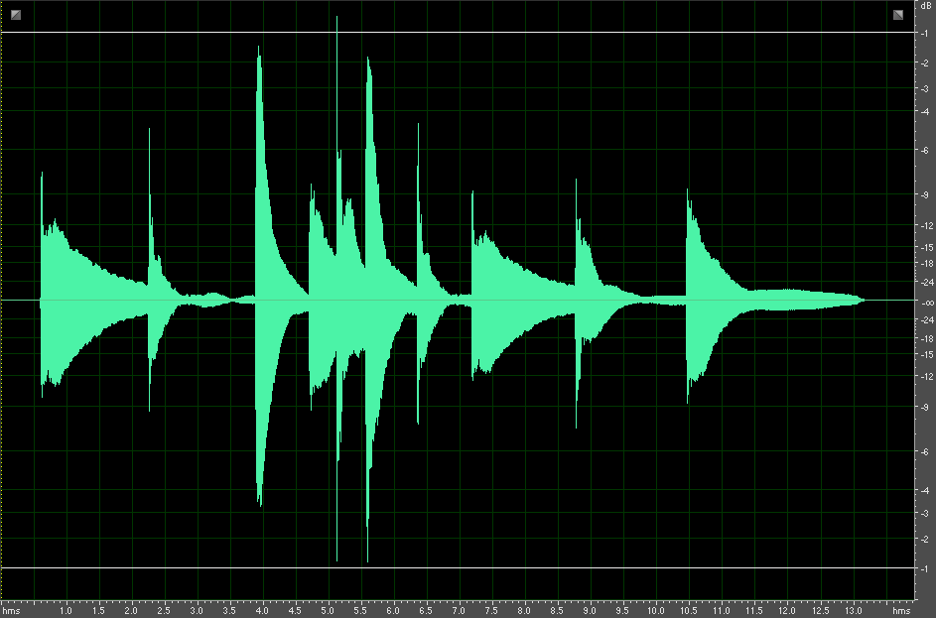
Music…
Over the Rainbow
(Piano Only)
amplitude
Some where over the rainbow way up high…
time
Notes:
Lets have a look at this problem in more detail. Here we show the sound waves of the first part of song ‘Over the Rainbow’. This image shows how the amplitude of the sound changes over time.

Slide 23
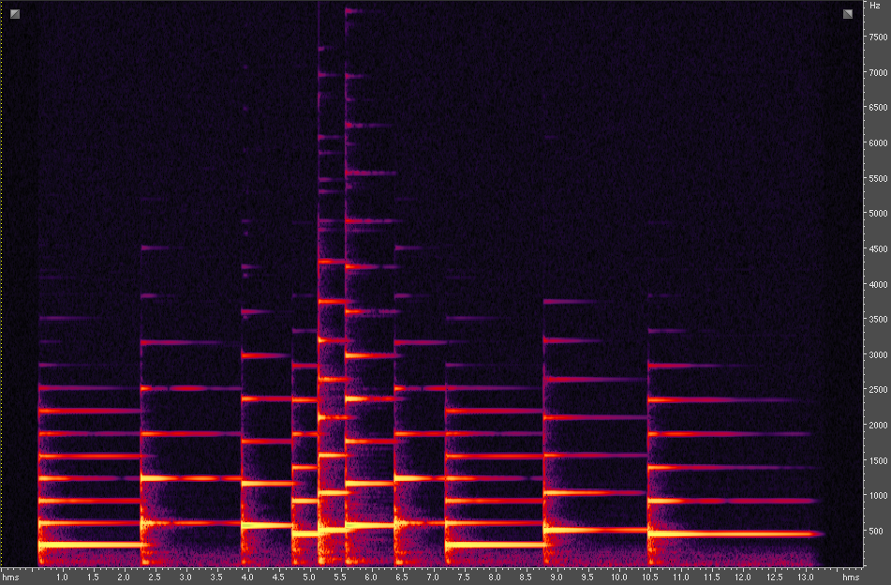
…is complex
(high)
Over the Rainbow
(Piano Only)
frequency
(low)
Some where over the rainbow way up high…
Notes:
We can also show how the same sound changes in frequency (or pitch) over time. This image looks more complicated – it shows the ‘frequency spectrum’ of each note and is called a ‘spectrogram’. Each note of the song has several lines, which are frequency components known as ‘harmonics’. For low pitch notes, the lines (harmonics) are closer together. For high pitch notes, the harmonics are further apart. The first of these lines is called the fundamental frequency, but the normal hearing ear uses all of the lines to determine the pitch of each note.

Slide 24
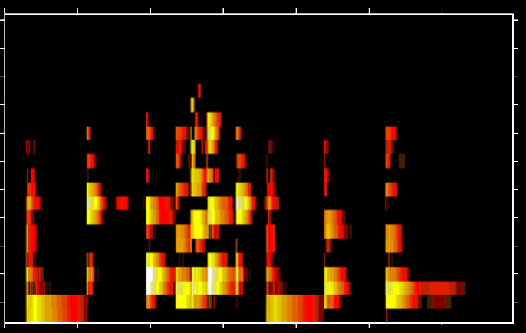
Filtered into >= 22 channels…
Over the Rainbow
(Piano Only)
(high)
Over the Rainbow
(Piano Only)
frequency
(low)
Some where over the rainbow way up high…
Notes:
However, cochlear implants have a maximum of 22 frequency bands. Here is the same sound again, but this time it has been filtered into 22 frequency bands. You can see that the harmonics are no longer clear and it is difficult to work out how the notes differ from each other.
Once the cochlear implant has filtered the sound into these frequency bands, it generates pulse sequences that will be delivered to each of the electrodes. Again, here is the same audio clip through an acoustic simulation cochlear implant.

Slide 25
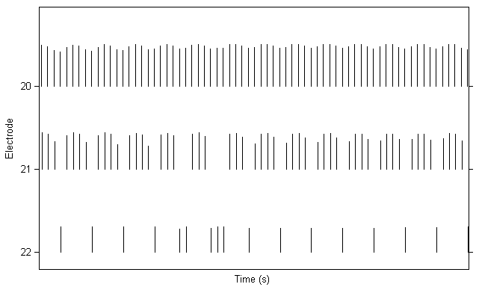
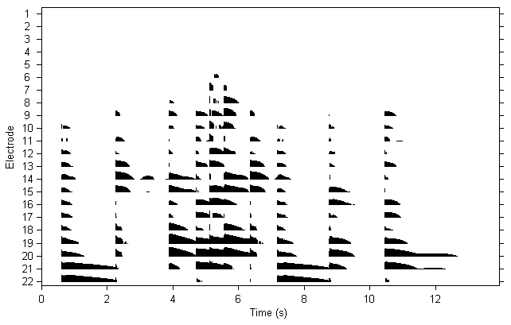
… and turned into pulse sequences
Over the Rainbow
(Piano Only)
Some where ov - er the rain-bow way up high…
Notes:
Once the cochlear implant has filtered the sound into 12, 16 or 22 frequency bands (depending on which make of cochlear implant you are using and how many electrodes are activated) it generates pulses sequences that will be delivered to each of the electrodes.
If we zoom in on this image you can see the individual pulses, which are typically generated at a rate of between a few hundred to a few thousand pulses per second on each channel. Although this pulse rate is fixed, the change in the height of the pulses as well as the presence and absence of pulses, can provide useful pitch information. The change in the height of the pulses (shown here by the red wiggly line) is referred to as the envelope. However, these envelope pitch cues are rather weak and they only occur on the low frequency electrodes (the electrodes that are at the deepest positions in the cochlea).

Slide 26
Limited ‘place cues’ for pitch
The normal cochlea has ~16,000 hair cells and many more nerve fibres, which provide fine pitch cues at different locations
Cochlear implants have between 12 and 22 electrodes and these can produce different pitches depending on their location
(the further into the cochlea, the lower the pitch)
Some electrodes may sound the same, resulting in even fewer place pitch cues
Notes:
To summarise, cochlear implants have limited ‘place cues’ for pitch. Any information or ‘cues’ about pitch that are provided by the location of stimulation in the cochlea is called a ‘place cue’.
The normal cochlea has about 16,000 hair cells and many more auditory nerve fibres, which provide fine place pitch cues for different locations in the cochlea. Cochlear implants have between 12 and 22 electrodes and these can produce different pitches depending on their location (the further into the cochlea, the lower the pitch). However, some electrodes may sound the same, resulting in even fewer place pitch cues.

Slide 27
Limited ‘temporal cues’ for pitch
The rate of the pulses delivered by the electrodes is fixed and is usually too high to provide timing or ‘temporal’ cues about pitch
Temporal pitch cues from the envelope of the pulse sequences are there, but they are weak.
Notes:
Cochlear implants also provide limited ‘temporal cues’ for pitch. The rate of the pulses delivered by each electrode is fixed in most implants and the rate is usually too high to use directly to convey pitch information using timing or ‘temporal’ cues. Temporal pitch cues from the envelope of the pulse sequences do exist, but they are weak and are most effective for low frequency electrodes (the electrodes that are most deeply inserted into the cochlea).

Slide 28

What if we used more electrodes?
More electrodes will not necessarily
result in better pitch perception due to:
  current spread
  (each electrode affects a large area)
  the condition of the cochlea
  (auditory nerve fibres may have degenerated)
Notes:
Unfortunately, having more electrodes does not necessarily help. The spread of electrical current in the cochlea affects a large area, so it is often not possible to tell the difference between two neighbouring electrodes. There also may be areas of the cochlea where the auditory nerve fibres do not respond to the electrical stimulation.

Slide 29
What will I learn in the next 25 minutes?
What a cochlear implant (CI) is and who can have one
What a CI sound processor does
How CI hearing compares to normal hearing
Why music is particularly challenging for CI users
How to get More From Music…
Notes:
Although music can be challenging for cochlear implant users, things are not all that gloomy!

Slide 30
Music ≠ Melody
Whilst it is true that pitch is important for melody, melody is not essential for music
Rhythm is conveyed very well by the implant
Loudness cues (although compressed) can convey the dynamics of music
Gross changes in the frequency spectrum are also conveyed by the implant
Notes:
It is important to remember that in order to appreciate music, you do not need to be able to hear the melody - melody is not essential! Rhythm and timing cues in general are conveyed by the implant very well.
Loudness cues can also be used to appreciate the dynamics of music. These cues, in combination with gross changes in the frequency spectrum can also be used to hear the lyrics, get the gist of the melody and determine the musical instruments that are being played.

Slide 31
What can help?
?
Music with clear changes in pitch
Music with a clear rhythm
Music will a simple arrangement
Appropriate volume
Quiet listening environment or direct input (TV/Hifi audio cable)
Clues for interpreting music (visual aids, lyrics etc)
Training & repetition…
Notes:
There are a number of tactics that can help cochlear implant users to hear music more clearly. For example: music with clear and large changes in pitch, music with a clear rhythm, music with not too many instruments playing at the same time, music played at an appropriate volume (not too loud and not too quiet), a quiet listening environment or direct input to the cochlear implant using an audio cable, visual aids and lyrics, and training... which leads me nicely on to plug the interactive music awareness programme that we have been developing with cochlear implant users at Southampton.

Slide 32
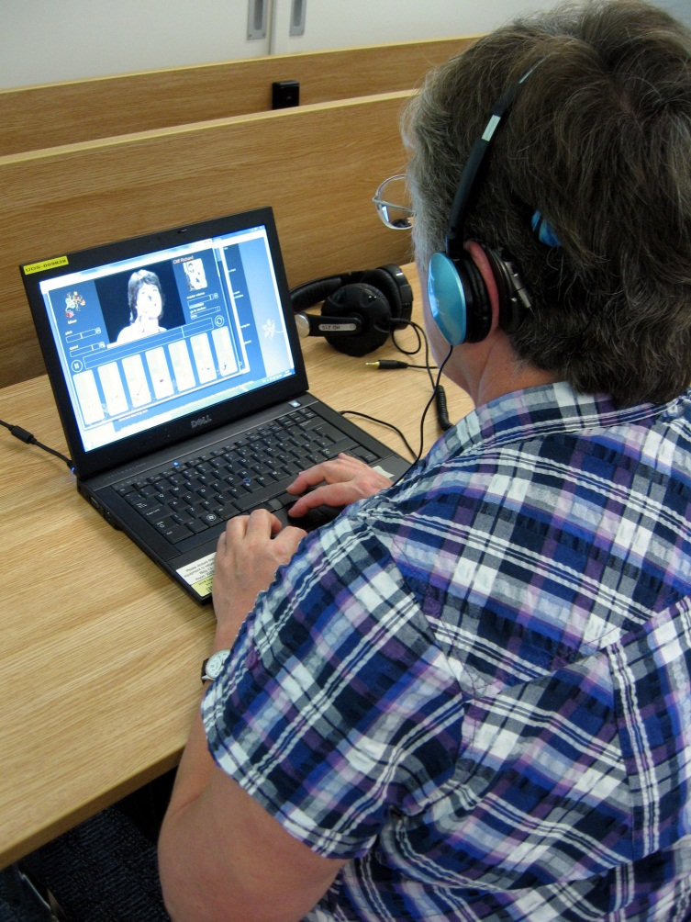
Interactive music awareness programme
24 x 30 min structured sessions
Interactive software applications enabling users to manipulate music to suit their implant
Uses subtitled video tutorials and written instructions
To be launched free online with a user forum ~Jan 2014 @ www.MoreFromMusic.org
Notes:
The ‘Interactive Music Awareness Programme’, or IMAP for short, is a programme of twenty-four 30 minute computer-based sessions with software that allows the user to create and manipulate music. It uses video tutorials and written instructions to guide the user through the sessions and each session ends with either a short test or directed listening task.
The IMAP will be launched free online with a user forum in January 2014 at www.MoreFromMusic.org

Slide 33
More From Music
Email us for further information…
Rachel: rvb@isvr.soton.ac.uk (project info, research collaboration)
Ben: b.oliver@soton.ac.uk (compositions, stems, software)
Sarah: s.m.hodkinson@soton.ac.uk (professionals’ training)
Mary: mlf@isvr.soton.ac.uk (workshops for patients)
or visit the music focus group website
www.soton.ac.uk/mfg
Notes:
For further information you can email me and the rest of the team, or you can visit our Music Focus Group website at www.soton.ac.uk/mfg
Thank you for listening – are there any questions?

